Slide 1
2021 Year in Review
Liberty Township, Delaware County

Slide 2

The Four Pillars
In 2021, the “Four Pillars” are considered and included in more day to day operational processes, as well as being incorporated into larger projects. As services were reviewed, changed or added, the “Four Pillars” provided direction on where to make adjustments to ensure our commitment to them and to our community were met.
Improve services to residents
Be fiscally responsible
Be innovative and improve processes
Be Sustainable

Slide 3
Board of Trustee
TOWNSHIP ADMINISTRATION

Slide 4
Communications
Communications Officer - Regular communications with the community via Facebook, Twitter, and Township website
“Notify Me” – easily reaching nearly 1000 residents with news flashes and special events
Multiple mail pieces to residents on specific topics: Comprehensive Plan Open House, Community Committees
Livestreaming of Board meetings – increasing viewership on YouTube

Slide 5
Planning & Development
Liberty 2040 Community Plan – project timeline and key targets have been established
Continued work with neighboring entities – City of Powell, Orange Township – to discuss shared visions, strategies, best practices
SMART development practices – POD 18D
Continued communication with businesses for economic development strategy – work with business stakeholders on Liberty 2040 and other projects

Slide 6
Township Staffing
Increased staffing in Parks & Roads to meet resident demands and needs and accommodate for special events and future growth
Staff Continuing Education and Training –AICP certification, SHRM certification, Leadership Delaware Program, “Unmanned Aircraft General” certification for drone usage, all Parks & Roads staff now CDL holders, 2021-2022 Ethics Training, all employees CPR/AED trained
Communications Officer now fully integrated in Township projects, events, etc.
Township Administrative Modular units are fully operational and have improved/streamlined many processes
Updates to all Administrative, Zoning and Parks & Road Services position descriptions

Slide 7
COVID-19 Pandemic Response
Administration and Zoning Offices are able to work fully remote if needed
Improved technology for all offices
Continued live streaming of Board meetings
Regular interaction and information sharing with Central Ohio public entities on best practices, strategies and pitfalls
Operations are fully functioning, with no decrease in service, while providing enhanced health and safety practices for the public and staff during COVID and beyond
Practices and communications improvements have resulted in low to no impact on services from COVID related absences

Slide 8
Administrative Offices
Fully operational in modular office units
Continuing to streamline processes and enhance services in preparation for move to new facility
New Administrative Offices and Township Hall plans in place
  Groundbreaking Ceremony – January 12th
  Estimated move in – October, 2022

Slide 9
Administration – The Four Pillars
Improved Services
Website Re-Design – on-line capabilities, information, communication
Staffing improvements and training –
On-line and no-contact Zoning application process
Youth Cricket Fields
Ice Skating Rink
Fiscal Responsibility
Enhanced, improved and added services for efficiency
Instituted Parks & Roads and Zoning fleet management
Revamped employee benefits programs for future savings
Innovate and Improve
Grant funding for trails and road improvements – Seldom Seen
Major technology improvements and innovations for increased productivity and remote work
Sustainability
Planning & Development – partnerships for future growth
Township Admin Office planning to service future needs of community

Slide 10
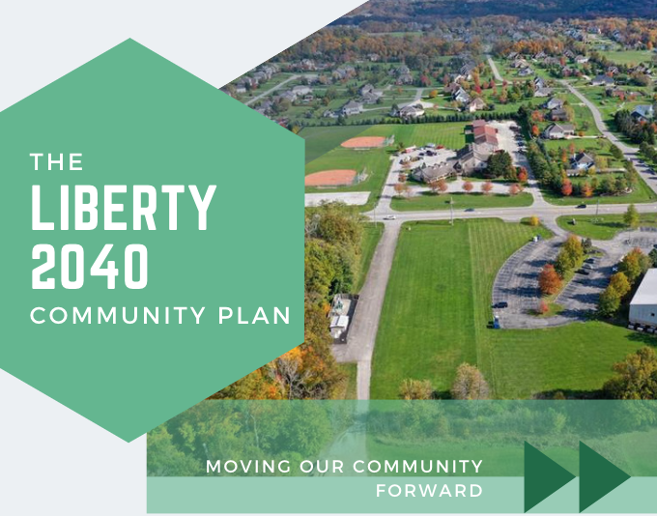

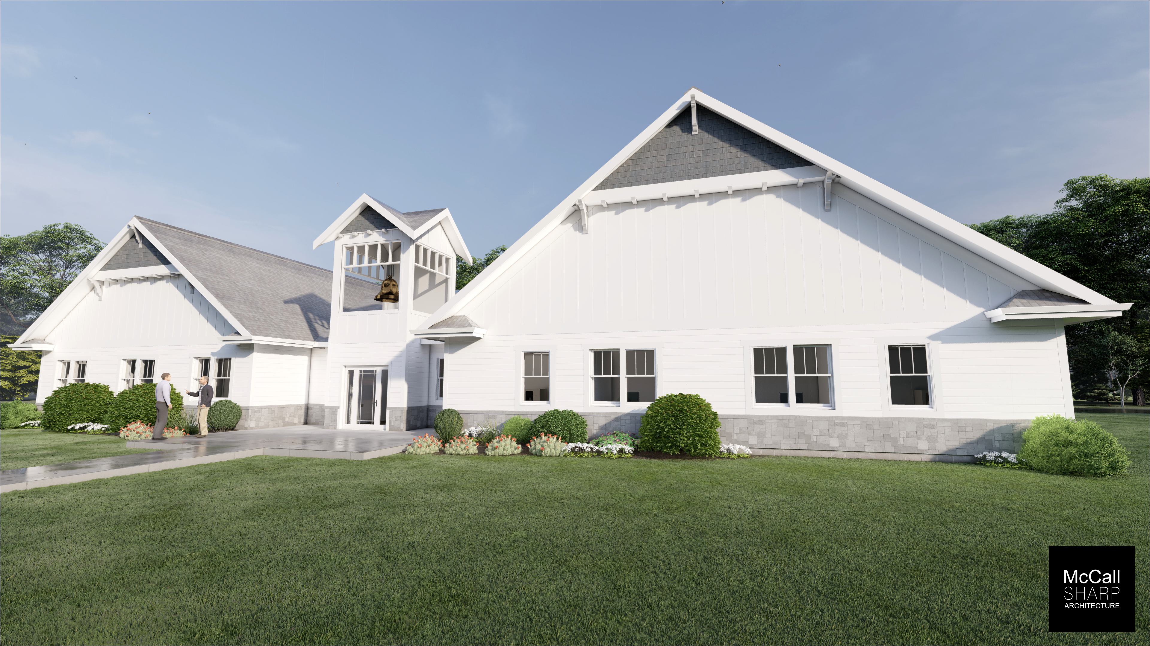

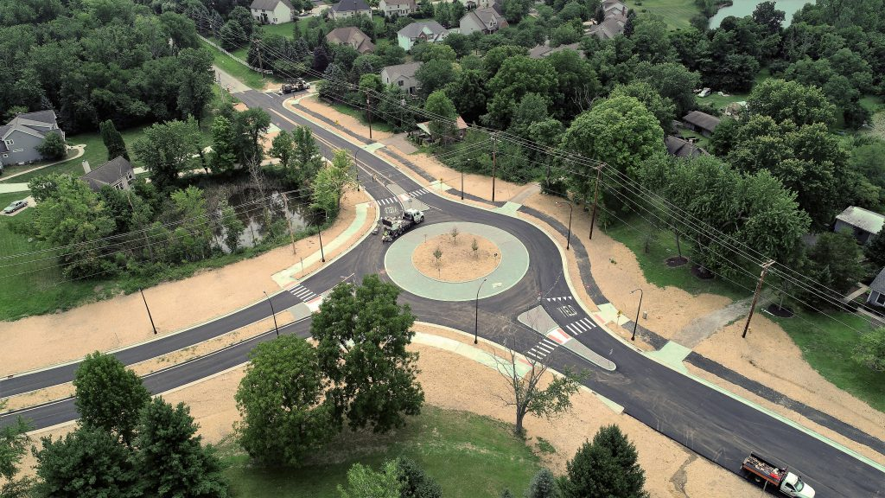




Slide 11
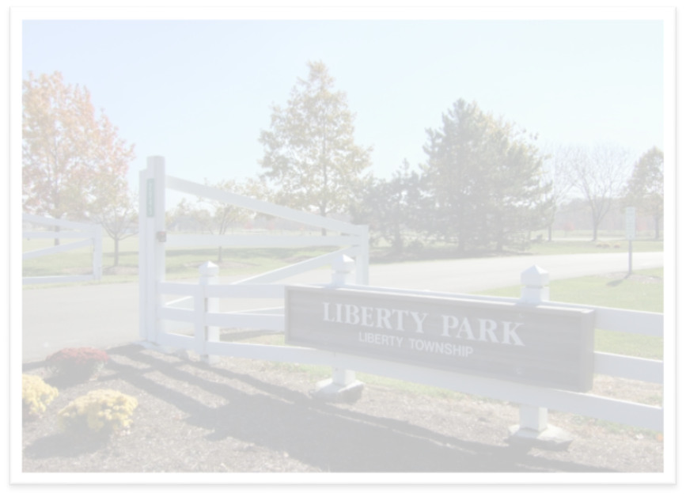
Parks & Road Services
Michael Landon, Park Supervisor
Park Improvements
Graveled 1.5 miles of trail at Havener Park
Tennis court resurfaced
Cooperative agreement with YMCA for youth summer camps
Replaced roofs on Park Office and shelter #4
Big Bear Park site work
Park Staffing
Increased staffing
Supervisory training

Slide 12
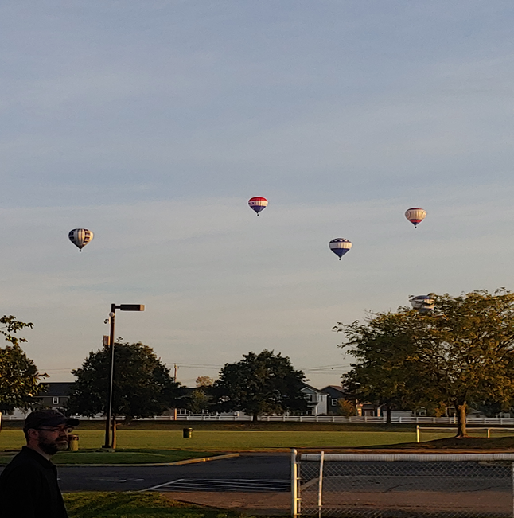
2021 Athletic Events
New & Updated contracts with OYAA, I-9, Little League, Classics/Eagles & Barcelona FC
550 soccer events
FC Barcelona Soccer Camp
Smoked meats competition
Tailgate Party
Balloon festival

Slide 13
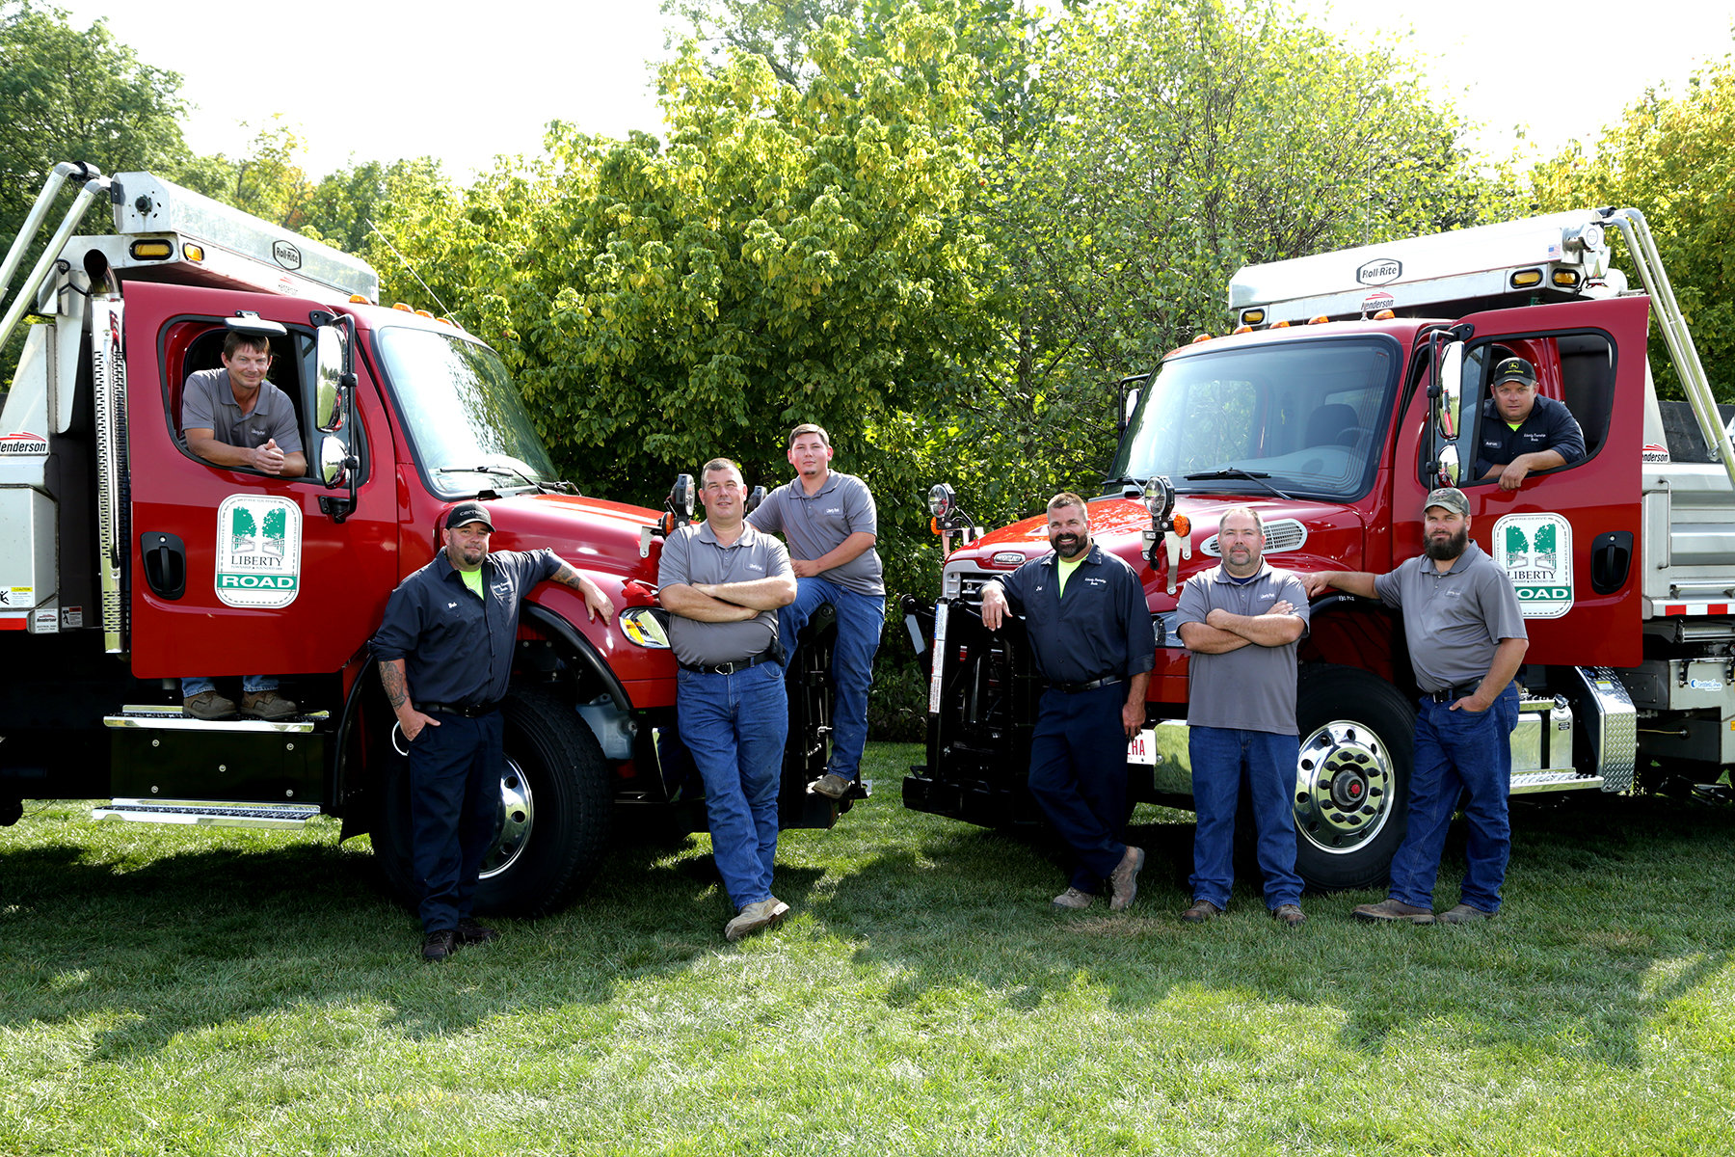
Parks & Road Services
Joel James, Road Services Supervisor
Road Improvements
ADA Ramp/Curb Replacement – Wedgewood Park
2021 Road Improvement Program
Flashing Stop signs – Manchester/ Salisbury
Crossover pipe replacement
Staffing
Supervisory Training
Equipment
2 Freightliners with snow and ice equipment purchased

Slide 14
Parks & Road Services
2021 Goals
Andy Curmode, Parks & Road Services Superintendent
Ethics and CPR training for staff
Balderson Grant application for ADA ramps
2022 Road Improvement Program
Coordinated various aspects of modular being installed at Liberty Park
Cemetery monument straightening and cleaning at Liberty Cemetery (5 rows)
Bike path construction from Torrington to Salisbury

Slide 15
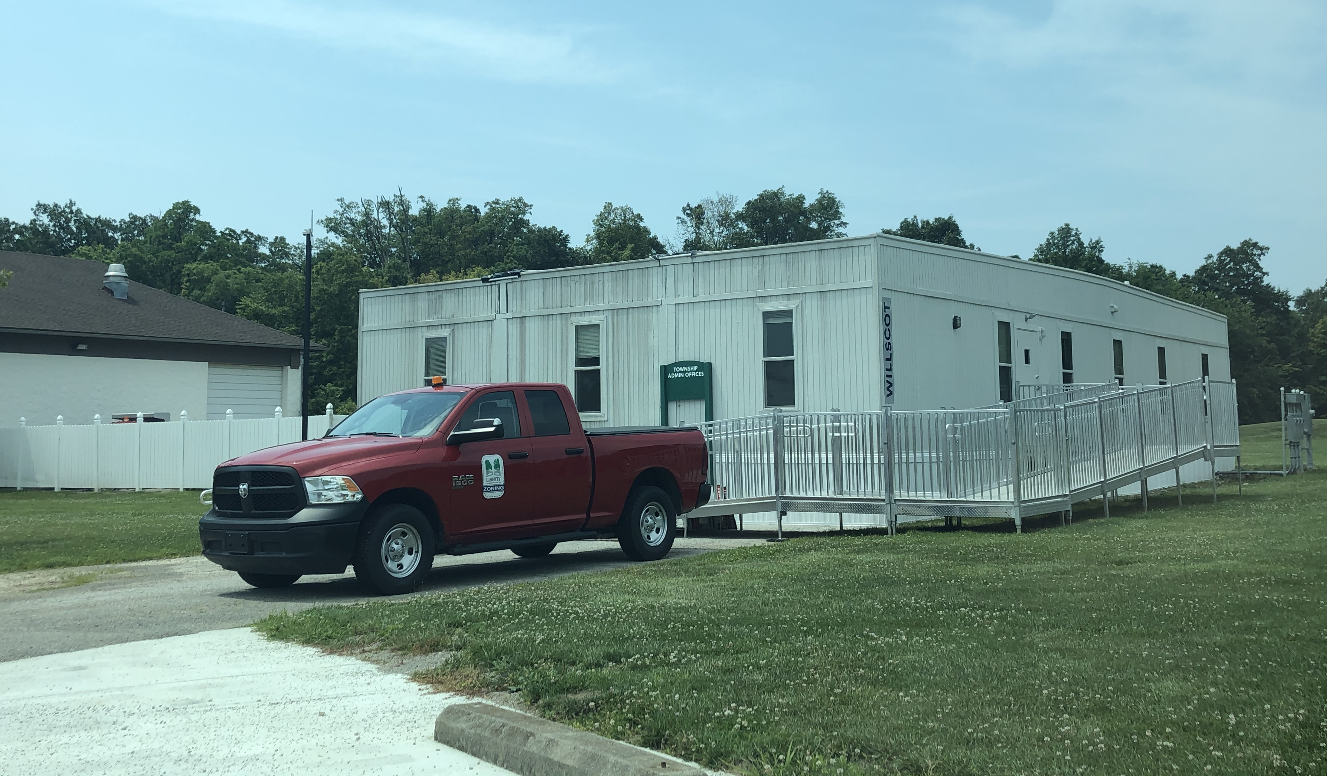
ZONING DEPARTMENT – 2021 HIGHLIGHTS
Tracey Mullenhour, Zoning Inspector
Eric Gayetsky, Code Compliance Officer/Field Inspector
Mary Beth Robinson, Permits Coordinator
Improved Services
Fiscally responsible
Improved process
  Zoning Permitting & Payments
    iWorq feature enhancement
    Online permit and payment options
  20% Revenue Increase ($67K)
  Staff Continuing Education
    Ohio Township Association Trainings
    Zoning Inspectors’ group seminars
  Digitization Initiative
  Drone Program
Sustainable into the future

Slide 16
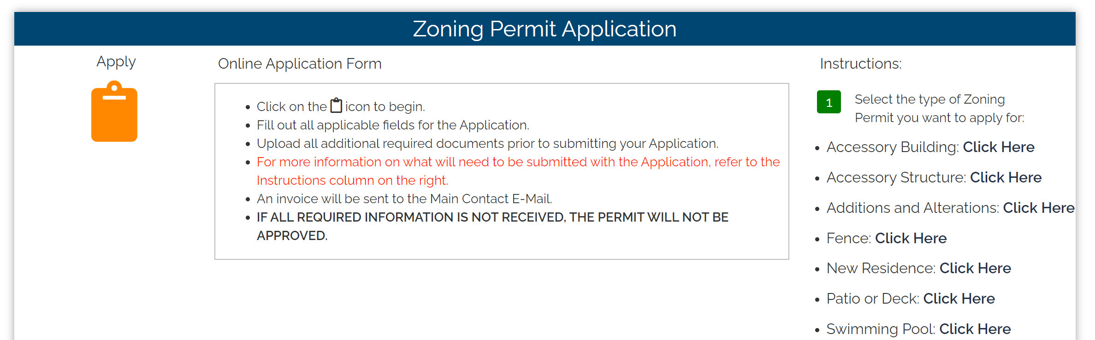
Zoning Permitting & Payments
iWorq – New feature that allows pictures to be displayed for easy identification
Online Permit Application and Payment Options
  New online zoning portal for permit application submittals and payments

Slide 17
Revenue
  Revenue increased by 20% in 2021 over the previous year
  Reflects increase in development and improvements
  Added staff and improved process to accommodate continued growth and development

Slide 18
Digitization
  Defined Scope of Project - Property Files (1956-Present)
  Vendor Interviews & Quotes
  Scanning Evaluations & Demos
  Administrative Staff Collaboration
Notes:
The top two features that ImageSilo has over the competition is as follows:
1) You have unlimited users with the software platform, which gives you the flexibility of adding as many users as your business deems necessary. There are no additional fees associated with adding or subtracting users.
2) Local technical resources for setting up ImageSilo and providing helpdesk support day forward.
We have been installing ImageSilo for over 20 yeas and our Solutions Architects are certified with Digitech. VRC is one of the top ten resellers in the country for =DigiTech.

Slide 19
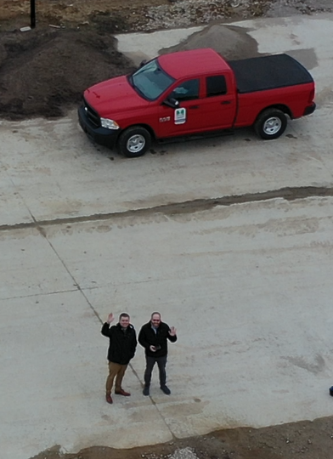
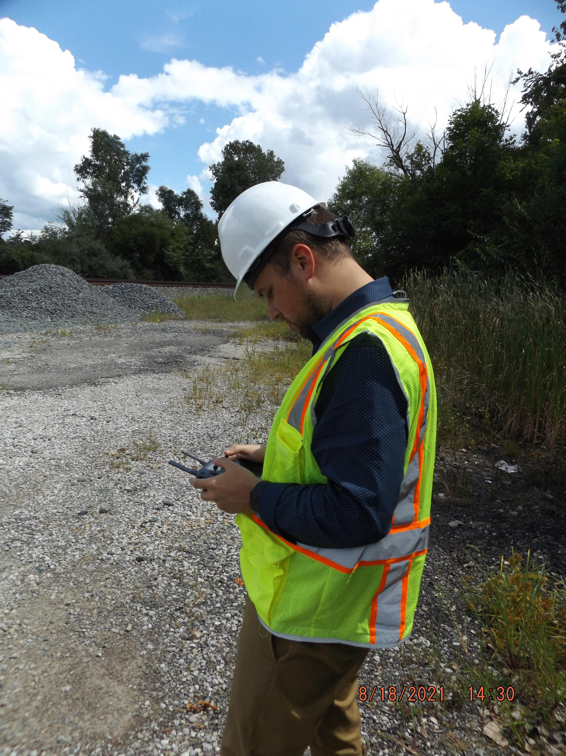
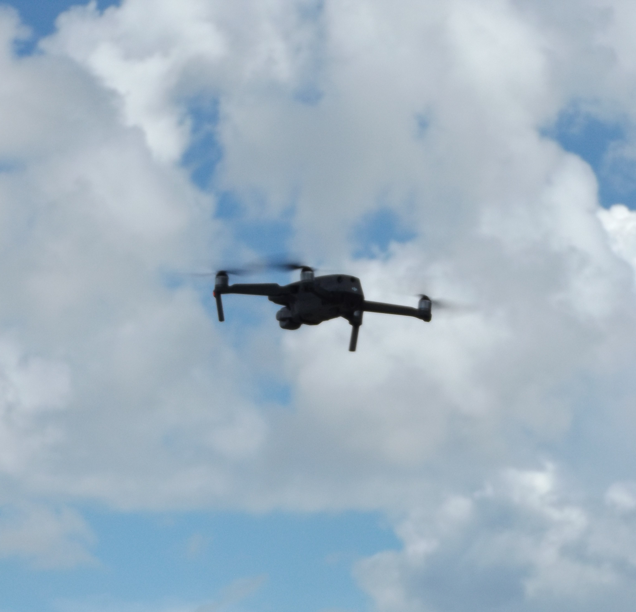
Remote Pilot Certification & Drone Program
Federal Aviation Administration “Part 107” knowledge test requirement
  Two Staff Obtained Certification
  Communications & Branding

Slide 20
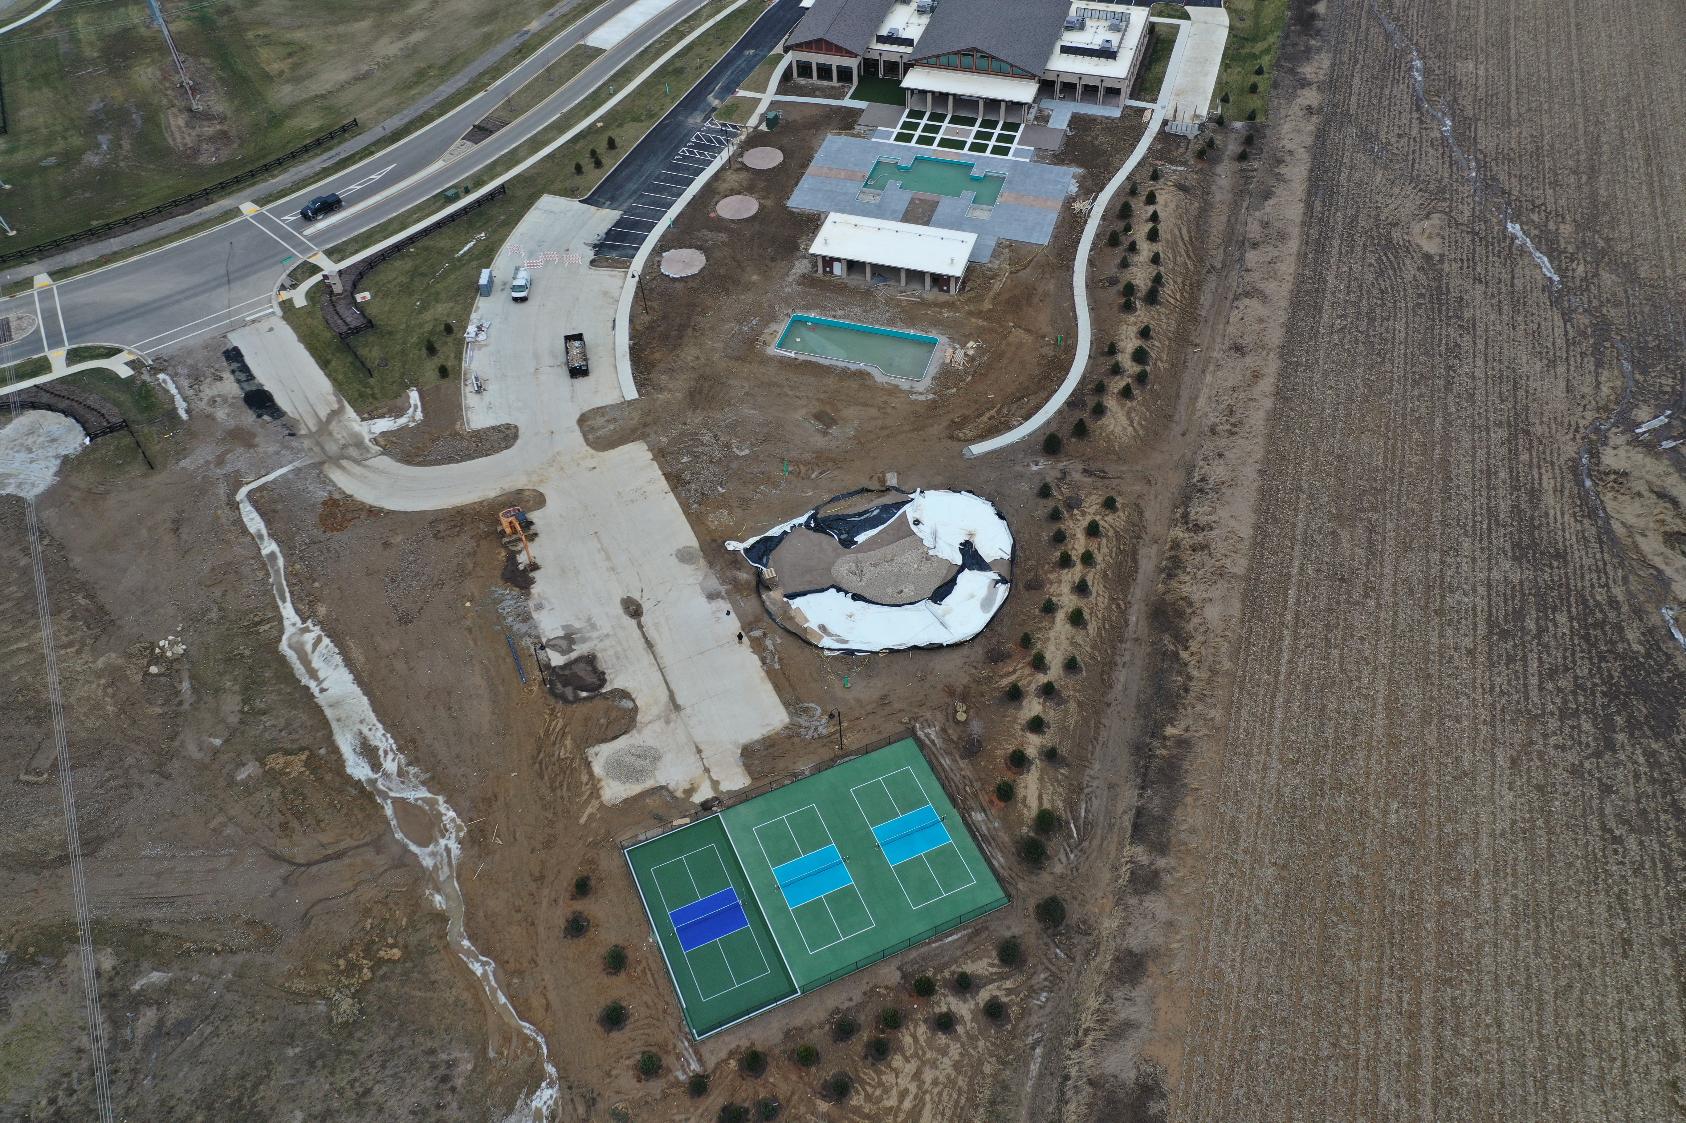

Slide 21
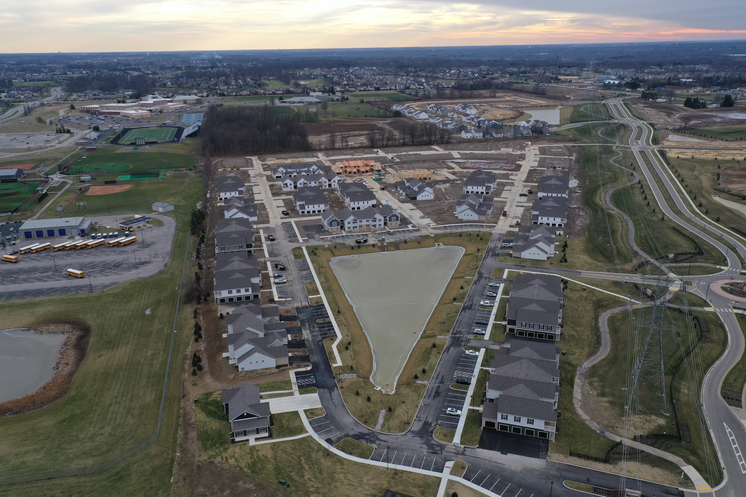

Slide 22
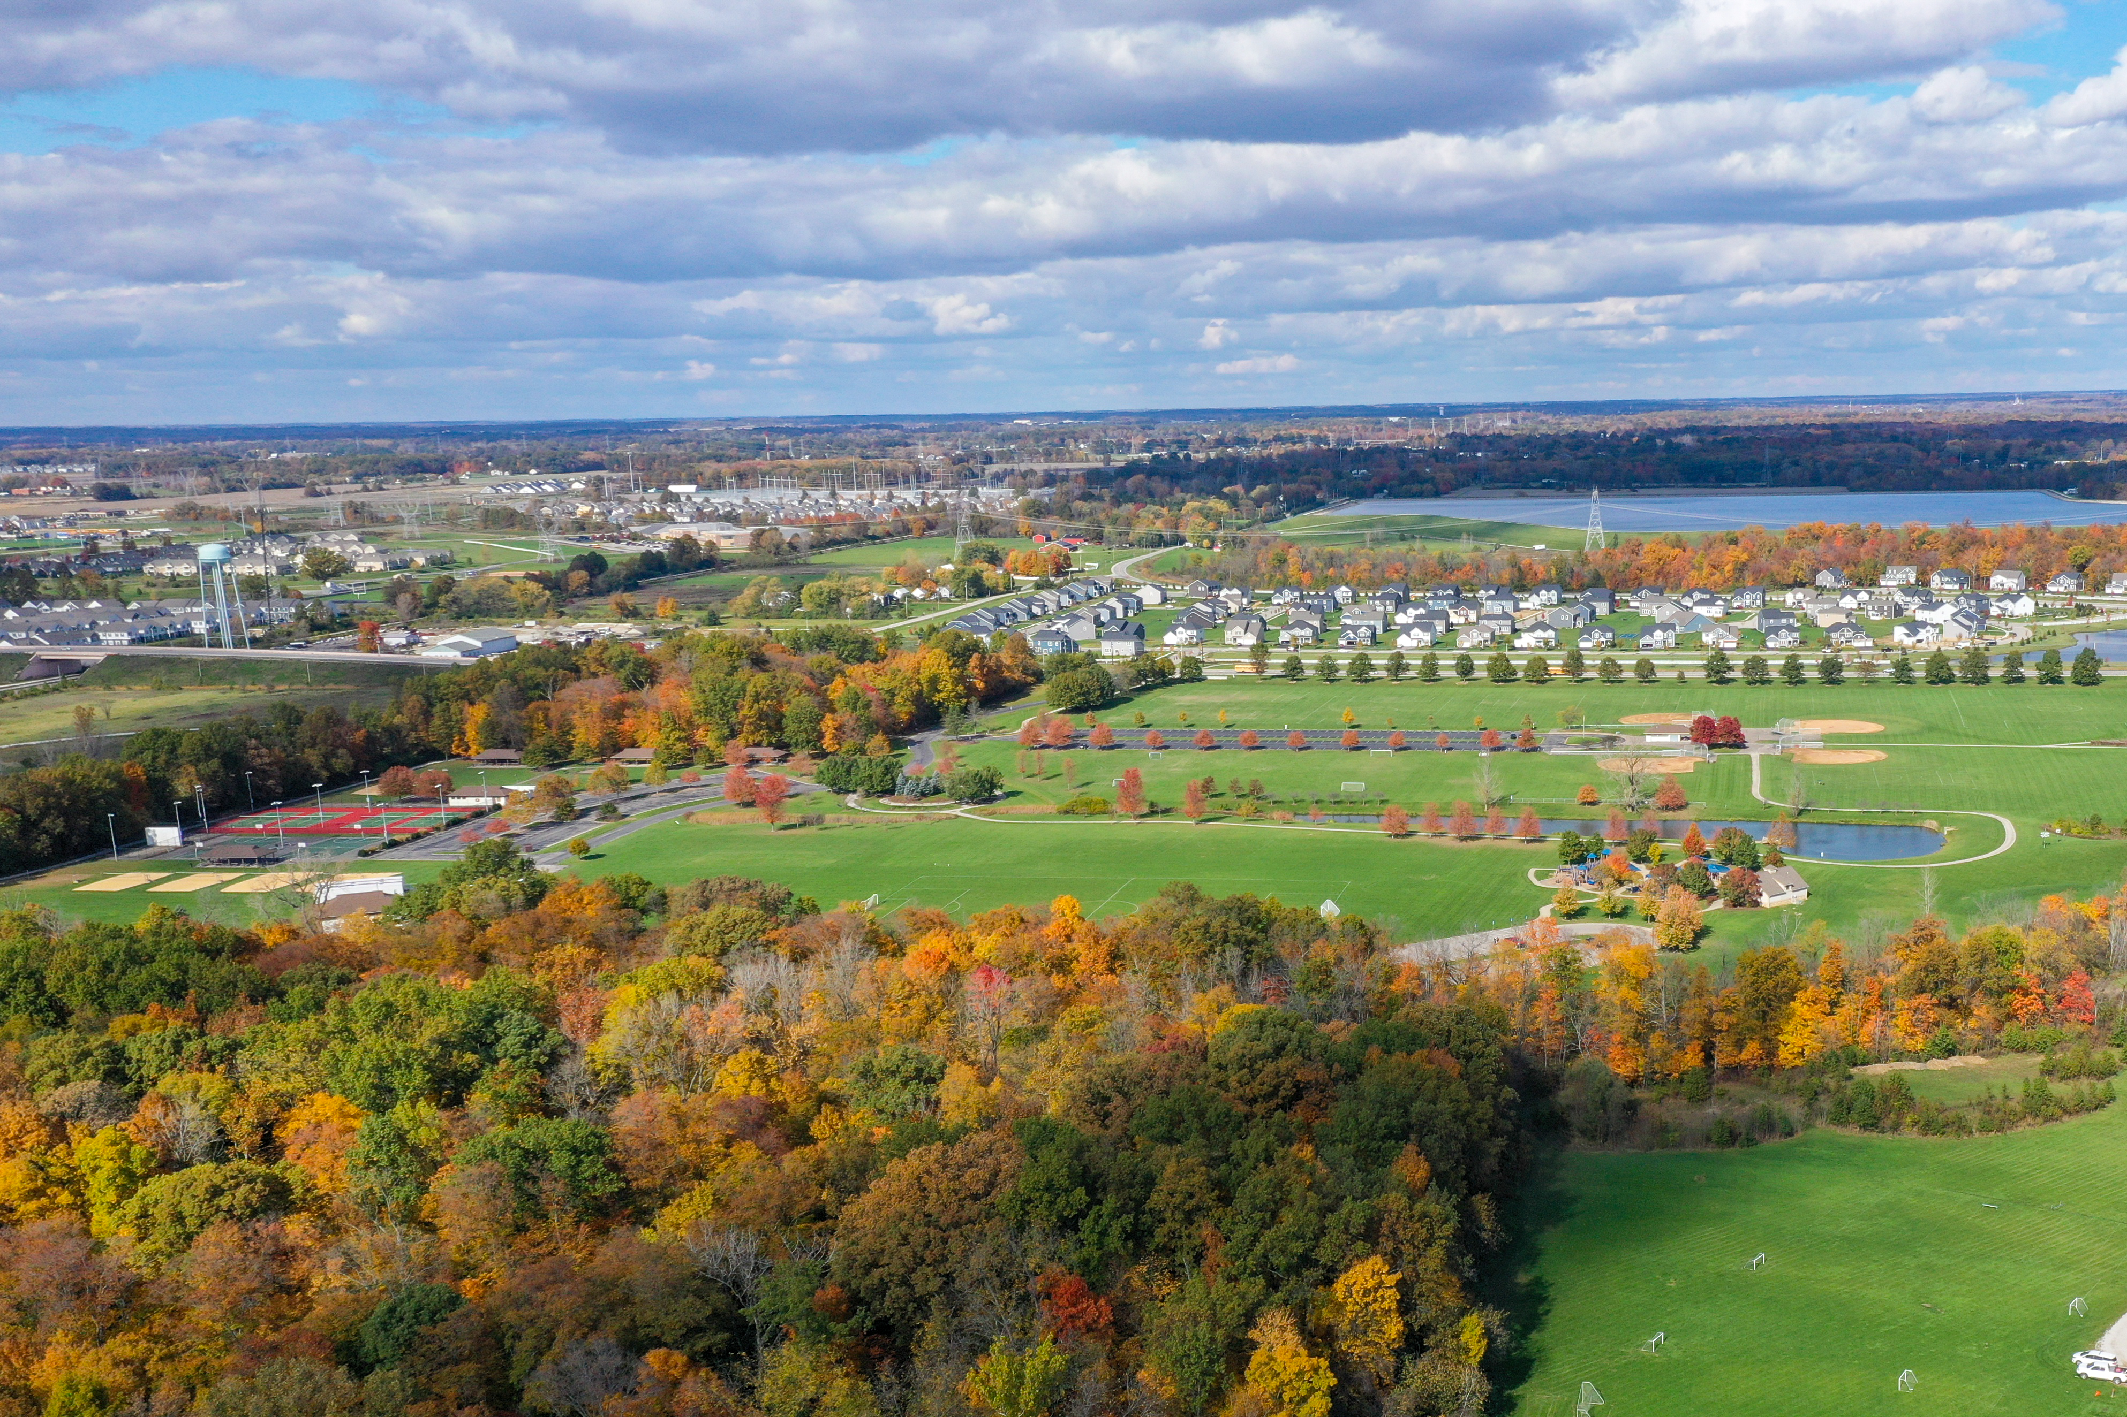

Slide 23
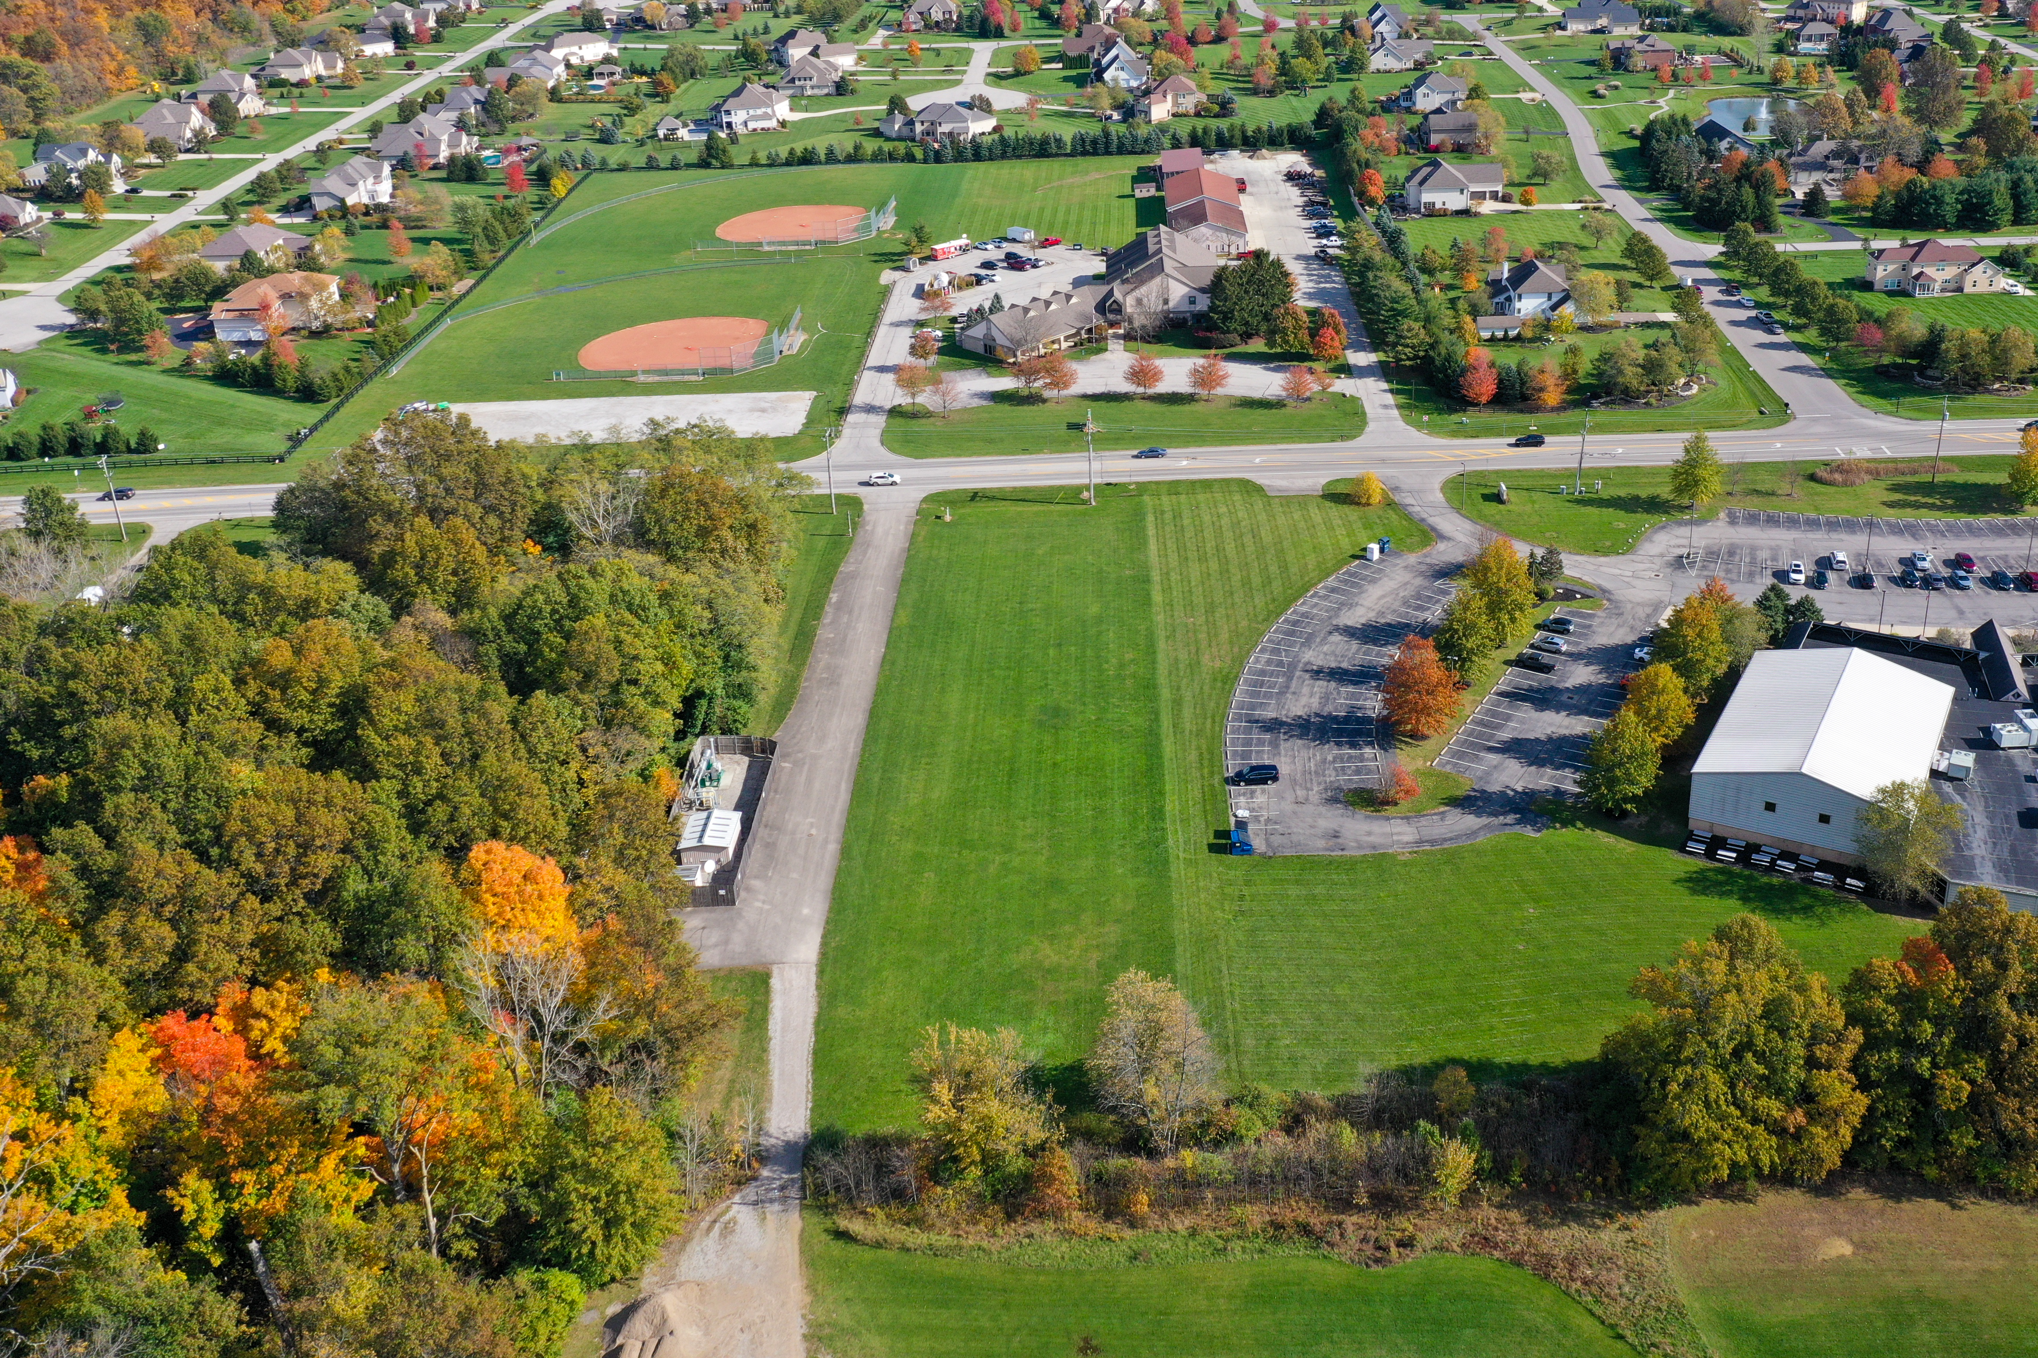

Slide 24
ZONING DEPARTMENT – 2022 GOALS
  Sustainability-Centered File Digitization
  Comprehensive Plan Support
  Continuing Education
  Drone Program Expansion

Slide 25
NOW…
ON TO A GREAT
2022!

